Slide 1
Rust:
the best and worst thing to happen to Tremor

Slide 2
Mario Ortiz Manero
💻 SWE @ Lyft
❤️ Open source
📧 marioortizmanero@gmail.com
🌎 https://nullderef.com
Llanes, Asturias, Spain
📍 Dolomites, The Alps

Slide 3
Let me tell you a story…
Mario Ortiz Manero
💻 SWE @ Lyft
❤️ Open source
🌎 https://nullderef.com
📧 marioortizmanero@gmail.com
Notes:
That’s me, remember my face.
Mario, SWE @ Lyft, love Open Source, created & contributed to many projects.
Contact: personal website for social media, or email
Today I wanted to tell you the story of when I contributed to Tremor, with Rust as the protagonist
Basically how the language shaped the development of the project with its good and bad aspects
I knew Rust beforehand, but I hadn’t dived deep enough until the mentorship (one of the reasons I contributed to Tremor)

Slide 4
But first, some context
Notes:
Initial context: I basically joined Tremor through the Linux Foundation
LFX Mentorship: Open source projects specify some task to be completed
Find your favorite and get it done
You get paid a bit, and learn from the journey and your mentors
Win-win: the open source project gets help and grows its community
Recommend it for anyone starting in their career

Slide 5
But first, some context
Notes:
For those who don’t know, Tremor is an event processing system
You take events that may happen (timer, HTTP server)
Events: logs, but a bit more abstract
Process them through a pipeline (filtering, transformations through their own language)
Output them somewhere else (DB, Kafka)

Slide 6
Let me tell you a story…
Notes:
To start our story, we have to go back to the very beginnings of Rust in Tremor.
Let’s take our handy time machine!

Slide 7
Once upon a time…
(Gary’s video)
Notes:
If you want to learn more about Tremor’s history, check out Gary White’s video from last year
Dives deep into why Tremor was created, and how.
You can learn a lot in terms of system design and how they work in real life scenarios
Objective: optimize Wayfair’s event processing stack at the time, so main focus is performance

Slide 8
Once upon a time…
Notes:
After establishing Tremor’s use-case
Important question: what tech are you gonna use, and what language.
Go: used in tools like Kubernetes successfully. But garbage collection is unpredictable, must be tuned, which is a pain according to Darach
C and C++ were viable but had lots of technical debt and overhead, Darach’s experience with it wasn’t super nice

Slide 9
high performance & robustness
Notes:
They decided to take a look at Rust, this shiny new language
Rust made it easy to follow good practices, and to write robust, scalable and maintainable production code
Super modern, learns from others. It’s my favorite, but some of its disadvantages aren’t that well known.
The performance requirements would be met, so they decided to give it a try

Slide 10
Let me tell you a story…
Notes:
I like to represent my journey with Rust as a flight of stairs
You start at the bottom knowing nothing
You advance step by step, slowly developing the product
Objective is reaching the top, which means you’re done
You’ll see that it’s not as easy as that, unfortunately

Slide 11
high performance & robustness
Notes:
That was the first step in the journey of Rust

Slide 12
high performance & robustness
Notes:
The first step of many
Rust ended up being a great choice
The team learned the language and became very productive
They built the core of the program with it

Slide 13
high performance & robustness
Notes:
And so it kept going…

Slide 14
…but also high compilation times
Notes:
Until we find our first problem with Rust
We fall into the abyss

Slide 15
…but also high compilation times
Notes:
Rust made it possible to be productive in writing high performance programs
Compiler has to do a lot of work for bigger codebases
Caused by generics, macros, type checking, optimizations

Slide 16
…but also high compilation times
Notes:
Tremor wanted to prevent increasingly annoying problems with compilation times
Tremor needs to support lots of technologies, protocols, and etc to receive and send the events

Slide 17
…but also high compilation times
Notes:
They started to look for a solution

Slide 18
…but also high compilation times
(Aleksey’s article)
Notes:
Fortunately, there are many ways to approach this
Check out Aleksey’s article for a few simple ideas you can apply
CI caching
Avoiding generics
Optimizing your dependency graph
Profiling compilation times to find worst dependencies
These are short-term solutions: if your project it’s big and requires lots of dependencies, then there’s not much you can do about it
Tremor’s developers wanted to future-proof it, thinking long-term

Slide 19
Plugin systems to the rescue!
Notes:
The most impactful solution is a plugin system, which works at the design level
You split up a binary into smaller components that can be compiled independently
Since they’re separate, if you change the code in one of these components, you don’t need to compile the rest, too

Slide 20
Plugin systems to the rescue!
Notes:
That way, we could continue using Rust in Tremor without as much usability overhead of compilation times

Slide 21
Plugin systems to the rescue!
Notes:
More benefits:
Flexibility of loading functionality at runtime
Modularity from new architecture

Slide 22
Plugin systems to the rescue!

Slide 23
Notes:
Turns out that implementing a plugin system in Rust is far from trivial!
We’ll take it slow and just go one step at a time, reaching smaller milestones

Slide 24
How to actually implement it?
Notes:
First milestone is technology
You can see that at this point I’ve given up in my career as an artist
I don’t know how to draw IPC or DL, but whatever, you get the point
The point is that we have many technologies that Rust supports
Multiple factors into account:
Secure
Backward-compatible with respect to previous and future versions of Tremor
Have a future
Support in Rust: usability, popularity, cross-platform
Most importantly, performance
Scripting languages: Lua, Python, more specific ones like Rhai
Easy to use and secure…
…but you would need to rewrite the existing code into the language
We can discard it

Slide 25
How to actually implement it?
Notes:
Everything is more fun with epic explosions

Slide 26
How to actually implement it?

Slide 27
How to actually implement it?

Slide 28
How to actually implement it?

Slide 29
How to actually implement it?

Slide 30
How to actually implement it?
Notes:
IPC: sockets, pipes, shared memory
Sockets and pipes are very easy to use (implementations like Actix or stdin/stdout)...
…but not efficient enough
Shared memory is very performant…
…but wildly unsafe, not well integrated in Rust

Slide 31
How to actually implement it?

Slide 32
How to actually implement it?

Slide 33
How to actually implement it?

Slide 34
How to actually implement it?

Slide 35
How to actually implement it?

Slide 36
How to actually implement it?
Notes:
Portable Binary Code Formats: WebAssembly, eBPF
More performant and usable than scripting due to no rewrites, and also sandboxing…
…but still not performant enough after some research & experiments

Slide 37
How to actually implement it?

Slide 38
How to actually implement it?

Slide 39
How to actually implement it?

Slide 40
How to actually implement it?

Slide 41
How to actually implement it?

Slide 42
How to actually implement it?
Notes:
Someone probably called the cops at this point, stop blowing stuff up
Which is ok, decision easy b/c nothing left to choose from:
Checks all the boxes, including performance…
…but has bad security and not the best support for reasons we’ll see later (good libraries, not-so-good language support)

Slide 43
Dynamic Loading
Runtime
Plugin
Plugin
Notes:
Dynamic loading is very popular in C and C++:
Splitting up binary into smaller binaries
Plugins export some functionality
Runtime can load the plugins at while running
For example, plugin that exports a set of functions to add support for JSON in Tremor

Slide 44
Dynamic Loading
Runtime
Plugin
Plugin
Notes:
Very efficient because it’s at binary level; runtime literally copies plugin into its own memory in order to access resources & make calls
We do meet the most important requirement I mentioned earlier

Slide 45
Dynamic Loading
Runtime
Plugin
Plugin
Notes:
Seems to be a great choice
First prototypes: calling external functions declared in Rust, and exporting/importing functions from separate binaries works

Slide 46
…except there’s no stable ABI
Runtime
Plugin
Plugin
Notes:
However, it’s not as easy as it seems with Rust, specifically
This is because even though there are no warnings from the compiler,
Calling external functions declared with Rust, and accessing external structs is undefined behavior

Slide 47
…except there’s no stable ABI
Runtime
Plugin
Plugin
Notes:
ABI defines: memory layout, function convention, etc
Unstable ABI means that these things can change in every compilation
You need to compile plugin and runtime separately, so the memory layout and function convention are unknown
This wasn’t so clear at the beginning, which is why I represent it as falling off the stairs
Many sources misunderstood the concept, community was confused
We can’t use Rust for plugins, basically
Note that this is many times good, since it makes it possible to change, among other things, the internal memory layout of data types to fix & improve stuff

Slide 48
We can use the C ABI!
Runtime
Plugin
Plugin
Notes:
It does have a solution, so we can dig ourselves out of the hole
But it’s not the best, because by resorting to the C ABI, our interface between plugins has to be at the C level:
No generics
No standard library types, and in turn, no external types sometimes
Main pain point: our types must be defined with the C ABI, which is a pain for external dependencies

Slide 49
We can use the C ABI!
Runtime
Plugin
Plugin

Slide 50
How to stay sane though?
Notes:
We know we can use C
Improving productivity?
A full-blown plugin system for a large codebase is hard

Slide 51
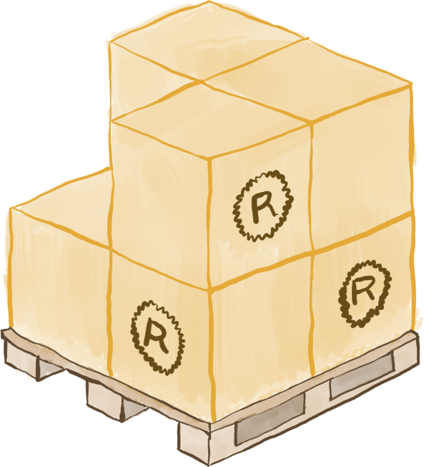
We can use existing libraries
abi_stable
async_ffi
glue
LCCC
safer_ffi
(...)
Notes:
We can rely on existing libraries, frameworks, or tools

Slide 52
We can use existing libraries
abi_stable
async_ffi
glue
LCCC
safer_ffi
(...)
Notes:
We can start to learn and use these libraries
Sometimes not easy to learn: abi_stable

Slide 53
We can use existing libraries
abi_stable
async_ffi
glue
LCCC
safer_ffi
(...)
Notes:
abi_stable provides a standard library with a stable ABI, and more tools to define your own types
Not only easier, but also much safer via static typing
async_ffi makes it possible to use async in the interface

Slide 54
…which aren’t production-ready
abi_stable
async_ffi
glue
LCCC
safer_ffi
(...)
Notes:
Libraries aren’t really production-ready

Slide 55
…which aren’t production-ready
abi_stable
async_ffi
glue
LCCC
safer_ffi
(...)
Notes:
Missing features or bugs we had to fix ourselves, that took at times weeks to solve
abi_stable is a huge effort, but also 1-man’s work. Not a lot of usage nor contributions.

Slide 56
Nothing we can’t fix ourselves!
abi_stable
async_ffi
glue
LCCC
safer_ffi
(...)
Notes:
33 external pull requests, 13 internal
It’s just gonna take more time

Slide 57
We can use existing libraries
abi_stable
async_ffi
glue
LCCC
safer_ffi
(...)
Notes:
In the end, everything works
Will get easier with time as they get more usage
I also wrote articles about it to improve the situation myself

Slide 58
How to leverage Rust?
Notes:
At the beginning we were talking about how Rust is a modern, robust & efficient language
How should we use it to its maximum potential to continue improving performance and productivity?
Has to do with issues found when fixing dependencies

Slide 59
Using advanced features
Notes:
Rust is a vast language with a ton of advanced features we can use to make our code tidier and more idiomatic.
I can’t imagine how big Tremor would be with C

Slide 60
Using advanced features
Notes:
What I used the most:
Macros: declarative and procedural
Generics
Type system
Crate features

Slide 61
Using advanced features

Slide 62
…some aren’t complete
Notes:
These advanced features may not be fully finished, properly documented, or easy to discover
Especially with stuff outside the Rust book

Slide 63
…some aren’t complete

Slide 64
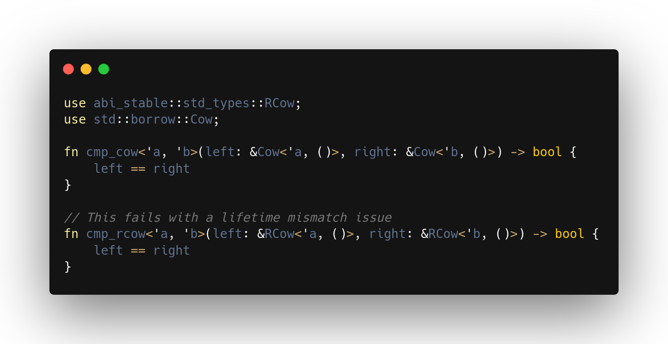
…some aren’t complete
Notes:
Subtyping and variance makes Rust’s lifetimes more flexible in some specific cases
I don't expect you to learn what variance and subtyping are, just in this talk.
Every type has a kind of variance: invariant, covariant, contravariant
(Cow) The one at the top is covariant
(RCow) Ours was invariant
You don’t explicitly indicate the variance
It’s inferred automatically from rules in the compiler based on how the type is declared
You have to check that you meet all of these rules
Could be important in edge cases: comparing different lifetimes won’t work for invariant types
Hard to know what’s going on if you don’t know about the topic, because it’s implicit
Newer versions of the compiler have warnings

Slide 65
…some aren’t complete
(Jon Gjengset’s video)
(Reference page)
(Wikipedia page)
(Rustnomicon’s page)
Notes:
Probably too short & vague, no time:
Check out these resources
Researching advanced stuff in Rust is harder than in C/C++
Looks like plenty of docs, but:
Not easy to discover: not popular
Some are a bit outdated
Not well explained (reference)

Slide 66
we can always figure it out!
(PR in abi_stable)
Notes:
Spent a couple of weeks until it was fully fixed

Slide 67
we can always figure it out!
Notes:
Help from the Tremor team
And creator of abi_stable with the final implementation
Proves nice community

Slide 68
Notes:
That was near the end of my project
I didn’t manage to complete the plugin system:
As it was specified at the beginning
Performance degraded by 30%, should be 10-20% for production
But my work is useful to not only the Tremor, but also the whole Rust community
Instead of going up the stairs one by one, they can take a shortcut to finish it

Slide 69
4 takeaways
Notes:
Takeaways: Rust is an huge step forward, but far from perfect

Slide 70
1/4
Notes:
High compile times:
Can become a problem in large projects.
There are fixes, and C++ isn’t better, but it hurts productivity
Tip: keep your architecture modular, not only into modules at compile time, but also different services, or in our case binaries or plugins.

Slide 71
2/4
Notes:
Being so fast-paced, it doesn't have a stable ABI:
Beneficial in some cases, not so much in others.
Tip: if you’re going to to rely on that feature, think about it twice. If you go for it, make sure your interface stays low level (or defined with C) since the beginning.

Slide 72
3/4
Notes:
Very new language in comparison:
It has lacking documentation or libraries in some cases.
Tip: try to contribute yourself whenever you can

Slide 73
4/4
Notes:
Some advanced features are either only available on nightly, or incomplete (GATs, const generics)
Nightly on production is bad idea
Tip: find a way around these issues, 99% there’s a fix. Also check out Nomicon in detail to be at least aware of the features, which is useful.
Others you should be aware of (steep learning curve and complexity), but these are the relevant ones for the story

Slide 74
4/?
Notes:
Others you should be aware of (steep learning curve and complexity), but these are the relevant ones for the story

Slide 75
Notes:
Still, Rust is a fantastic language
If you come across an issue that’s not that well documented or popular, please help!
Usually super easy & friendly process, just one PR away, and that’s the best way to progress.

Slide 76
Notes:
Take this talk with a grain of salt, do your own research:
It only focuses on the bad parts
Somewhat anecdotal

Slide 77
Q + A
(NullDeref)
(Tremor)
Notes:
If you have any questions I’ll be available now!
You have lots of details about the journey on my personal blog
I wrote everything in there as I was working on it to help out community
Still have to write a couple articles, about the lifetime issues
Also check out Tremor’s site, with more information about it
Please come to the Discord server to say hi

